Slide 1


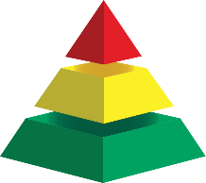

WELCOME
Educator Wellness Plenary
A Self-Care Moment to Reduce Your Stress & Anxiety Through Mindfulness and Movement
Cristy Clouse cristy@pbiscaltac.org
Henri Maddocks henri@pbiscaltac.org
Notes:
Hello everyone and welcome to the last part of the day the educator wellness plenary – this is a time for you to sample some self-care strategies to destress the distress going on around you. We recognize that Self-care is an individual thing and we hope you might add something new to your repertoire of self-care by attending today
Last time if you were with us, we introduced the 4 Pillars of a Healthy Mind (from the center of HM), practiced the foundations of mindfulness and introduced NVC as a way to resolve conflict and encourage positive relationship building
This afternoon as the title says we will take a self-care moment to reduce your stress and anxiety through mindfulness and movement.
I am Cristy Clouse – the VP of Innovations CalTACPBIS and Coordinator of PBIS trainings. I have been in education for over thirty years but I must say My life changed 20 years ago when I became a PBIS coach at my school site, then district, then county office. During my thirty years in education I practiced yoga as my self-care go-to and have even taught yoga to my middle school students, - which I must say I needed to destress my distress with yoga after I taught those MS students yoga….!
Cultivate Your Well-Being Through Traumatic Times
Trauma is any deeply distressing or disturbing experience that overwhelms a person’s capacity to cope.
Secondary traumatic stress (Vicarious Trauma)is the emotional duress that results when an individual hears about the firsthand trauma experiences of another.
Trauma leaves a lasting impression on the mind, body, and brain; Even though the impact of different types of trauma can vary, the body still absorbs the traumatic experience.
Traumatic experiences are stored viscerally, so working through the body and movement is critical in being able to regain some control over the body’s response.

Slide 2
REFLECT on “WHY”
you are part of high school reform
ENCOURAGE
coalescing around the topic
CELEBRATE
participation and involvement in the transformation
AUTHENTIC ENGAGEMENT

Slide 3

Creates a safe, supportive space to explore emotional regulation through the connection with breath and increased body awareness.
CREATE
YOUR
SPACE
Notes:
Creates a safe, supportive space to explore emotional regulation through the connection with breath and increased body awareness

Slide 4



GROUNDING
Notes:
Henry….

Slide 5
INVITATION #1
Appreciative
Inquiry
INVITATION #2
Inner Awareness
Outer Senses
INVITATION #3
Mindfulness in Movement
Notes:
Cristy

Slide 6
Invitation #1
APPRECIATIVE
INQUIRY
Notes:
The skill of appreciation is to notice the positive
Appreciation allows you to detach from a stressful period and savor a positive memory or experience.
A positive focus can create a positive sense of well-being.
Expressing appreciation and gratitude has multiple winning effects on the brain
increases dopamine (increase duration and experience of positive emotions, and promotes prosocial behavior)
increased serotonin production (the happiness chemical that contributes to feelings of well-being stabilizes moods and elevates a sense of relaxation)
increased activity in the medial prefrontal cortex (area linked to learning and making decisions)
activation of the brain’s ALTRUISM and Reward System Regions (the brain craves the experience of giving)
“What’s the best thing that has happened to you yesterday?”
Asking this playful question can serve as a bridge to connect the shared spectrum of emotions that shape the experience of others, leading to increased understanding, greater tolerance and heart-felt connections (at the same time distracting you from stressful moments)

Slide 7


What’s the best thing that has
happened to you today?
Focus on the Positive to THRIVE

Slide 8
Invitation #2
Inner Awareness
Outer
Senses

Slide 9
Invitation #3
MINDFULNESS IN MOVEMENT
Notes:
Mindful Movements can reduce the physical effects of stress on the body. The body responds to stress through a fight-or-flight response, which is a combination of the sympathetic nervous system and hormonal pathways activating, releasing cortisol – the stress hormone – from the adrenal glands. Cortisol is often used to measure the stress response. Here are some mindful movements has been demonstrated to reduce the levels of cortisol.
We are going to combined movement with connecting ourselves to the present. The more aware we become of our surroundings and the world around us. It opens the way to improved concentration, coordination, reaction time and memory.
Meet yourself where you are…To get the most out of this short practice, take note of the sensations that move throughout your body as you come into each movement. Allow yourself to feel and experience whatever arises.

Slide 10

Notes:
Invitation for Mindful Movement
Starting with subtle movements
Visualization with Nature as our backdrop
Mountain Pose
Feet as the Base
Shoulder rolls
Neck
Top of Head – Peack
Natural Breath/ Eyes closed or downward gaze
What do you notice
What are you curious about

Slide 11
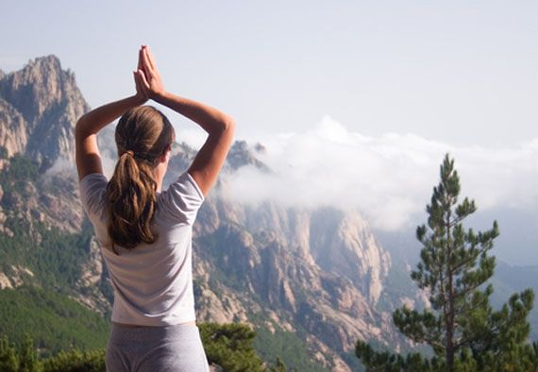
Notes:
Visualize your favorite kind of tree
Pine Tree in Picture
Olive Tree in my mothers front yard
Rooting
Raising branches/arms up and down
Moving fingers / leaves
From grounding to balance
Balancing our brain hemispheres
Movement of foot
Back to standing, grounding, shoulders, neck top of head
breath

Slide 12

Notes:
Back to standing, grounding, shoulders, neck top of head
breath

Slide 13
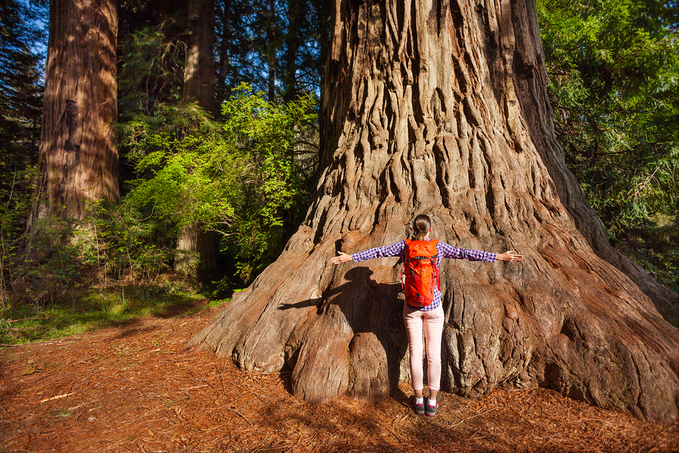
Notes:
Before we leave TREE pose
Lets hug our tree
Arms stretched out wide
Cross at the midline
Hug yourself – squeeze release squeeze release

Slide 14
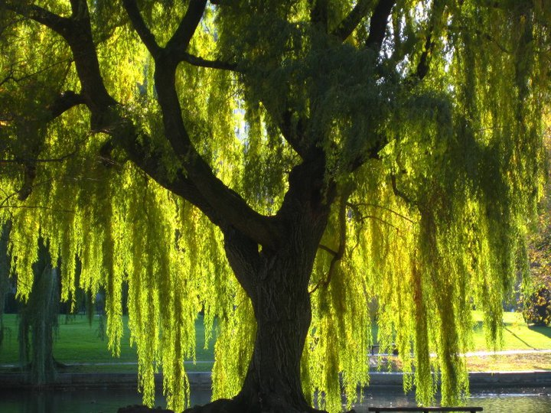
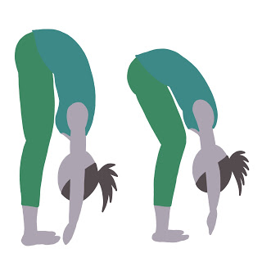
Notes:
Visualize a willow tree with branches hanging loosely and lightly towards the ground
Forward bends are the best way to calm your nervous system…calming your parasympathetic nervous system
Sway in the breeze
Slowly roll up one vertebrae at a time
Standing rooting, grounding breath

Slide 15
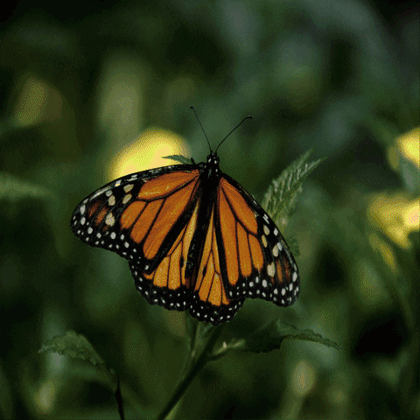

Slide 16
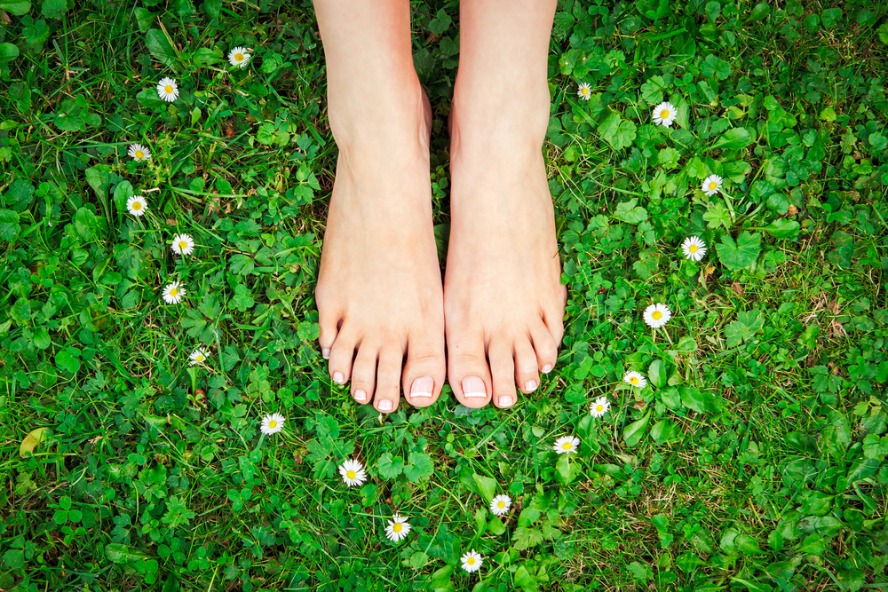
Notes:
WALK in Nature
Barefoot on the grass/sand/?
Find our connection again.
Walking barefoot regulates the nervous system, decreasing feelings of anxiety and stress. Going outside, in general, can help regulate emotions and balance the nervous system. However, letting your body come in contact with the soil directly decreases anxiety and stress even more.
Also called “earthing” or “grounding,” the simple act of walking barefoot offers so many benefits that often get overlooked by mainstream society pushing the importance of wearing shoes at all times. According to Dr. Mercola, walking with your feet directly touching the soil allows your body to absorb negative electrons through the Earth, which helps to stabilize daily cortisol rhythm and create a balanced internal bioelectrical environment.
We have lost much of our connection with Mother Earth due to modern living. But making an effort to spend more time barefoot in nature can provide more benefits than you would think.

Slide 17

https://docs.google.com/forms/d/e/1FAIpQLSfUgms1_c6cFzPQXL49hYI28e6j4qhsfOVSpdEU9yzBU-edbA/viewform?usp=sf_link
Enter the RAFFLE for a free
SPRING HSPBIS Symposium

Slide 18
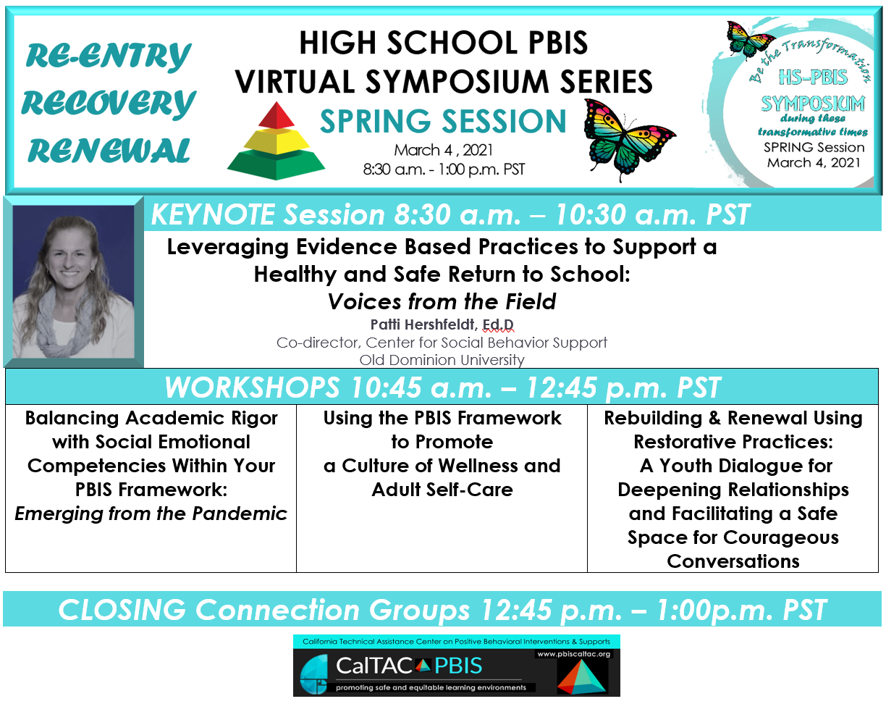
https://form.jotform.com/210124246792148

